Slide 1
CS 2033 Multimedia & Communications II
Lecture 10 – CMS AND E-COMMERCE WEBSITES

Slide 2
What is a CMS?
Content Management Systems (CMS) are useful website platforms.
They make it easy to create and maintain websites without having to know any code.
The content is separated from the code so website content can be updated in a visual interface.

Slide 3
What is a CMS?
Consider a large website like Wikipedia.org or msn.com.
Imagine how time consuming and complicated it would be to update content if it was within the code.
Instead, the code and content are split up into separate components.

Slide 4
What is a CMS?
Main advantages of using a CMS:
Split content from code
Keep job roles separate
Keep the site more organized
Pre-made themes
Many easy-to-add modules
Built-in SEO

Slide 5
What is a CMS?
How does this work?
Content is typically saved into a database or external files.
The code is used for the website layout and template.
The code also loads the content from the database.
Note that HTML cannot load from a file or database; use PHP or ASP.

Slide 6
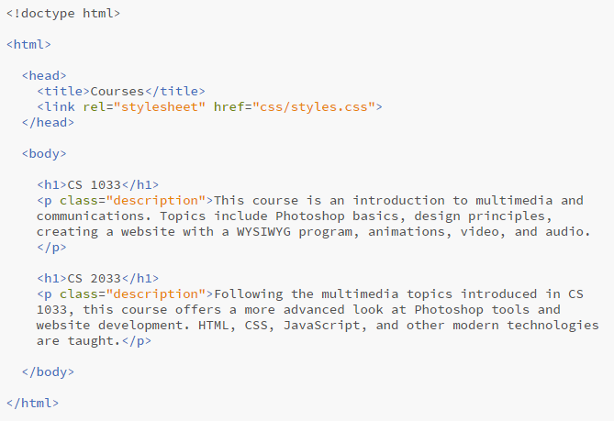
What is a CMS?
Content within code

Slide 7
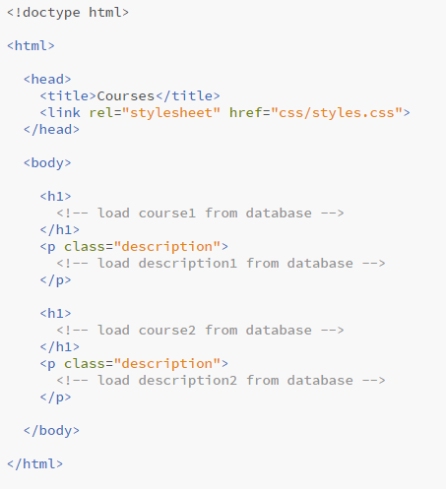
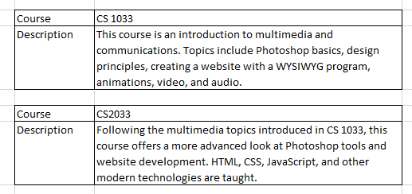
What is a CMS?
Code without content
Database

Slide 8
What is a CMS?
By splitting up the code and content, these websites can have distinct team members.
Editors – writing/creating content only.
Programmers – making the layout and handling other functional modules.
Neither one has to deal with the other since they are completely separated.

Slide 9
CMS
This is not only used for large, complex websites.
Many websites now use CMSs.
News sites
Blogs
Sites with articles
Sites with changing content
Wikis (more on wikis shortly…)

Slide 10
CMS
CMS platforms:
WordPress (most popular one)
Joomla!
Drupal
Cascade (UWO uses this one)
Big companies may create their own CMS instead of using one of these.

Slide 11
WordPress
WordPress is free and easy to use.
After registering, they provide you with an online control panel, shortened to cPanel.
cPanel is used by other platforms as well as WordPress.
cPanel is the main hub for editing the site without touching code.

Slide 12
WordPress
Posts vs. Pages
Posts are for articles, news items, products, etc.
Pages are whole webpages
Posts generally don't have a fixed web location, which is unlike webpages
Blog pages usually contain one or more posts
WordPress allows you to create both

Slide 13
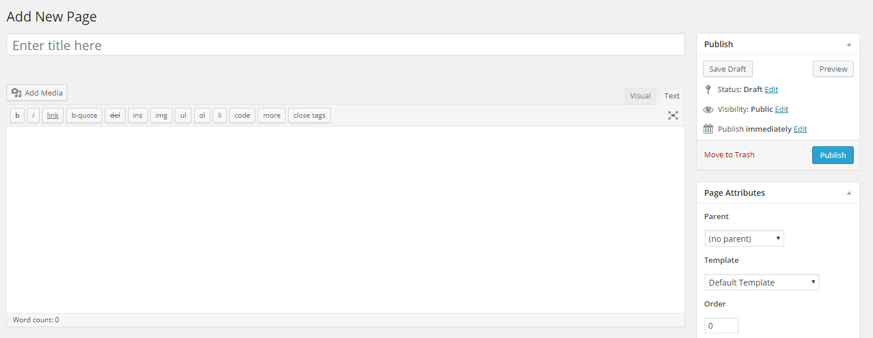
WordPress
Adding a page in the WordPress cPanel

Slide 14
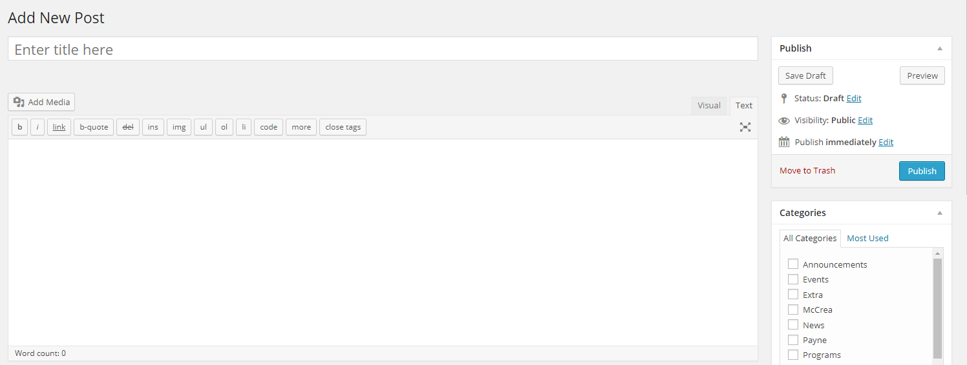
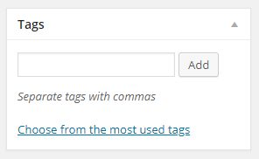
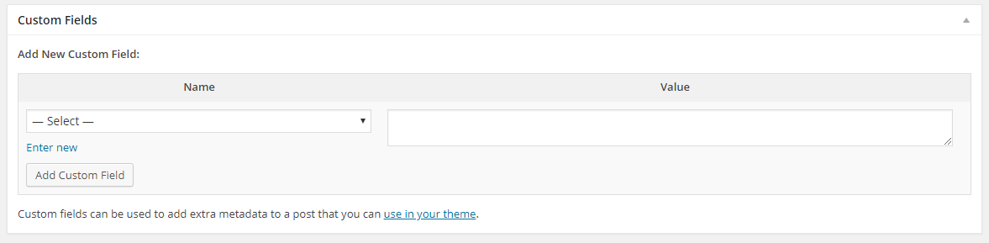
WordPress
Adding a post in the WordPress cPanel

Slide 15
WordPress
WordPress themes:
Pre-made templates that are customizable
Comes as a folder of many code files (PHP, CSS, etc.)
Free or purchasable
Great examples:
https://athemes.com/airi-demos/

Slide 16
WordPress
Who actually uses WordPress?
The Walt Disney Company
Walking Dead
Snoop Dogg
Palasad
Many many others

Slide 17
Wiki
What is a wiki?
To help answer this, think about Wikipedia.
What is a unique feature of Wikipedia?

Slide 18
Wiki
Wikis are special kinds of CMSs.
Collaboration is key with wikis.
Many users contribute to the website's content.
Wiki means "quick" in Hawaiian.
They are seen as quick and simple because the content is added by a community rather than one person.

Slide 19
Wiki
Wikipedia is the most popular wiki.
This is a public wiki, meaning anyone can edit it.
Some wikis are private so only select communities or user groups have access to view or edit them.
OWL is an example of a special, private wiki!

Slide 20
e-commerce
e-commerce (also written as eCommerce) is online vending.
Selling or purchasing anything online counts as e-commerce.
This includes ordering a pizza from the Pizza Pizza website/app or a meal through Uber Eats or Skip The Dishes.

Slide 21
e-commerce
Shopping for clothes, electronics, books, games, food, and virtually all other products.
Examples of e-commerce websites:
Amazon
Walmart
Best Buy
Uber Eats

Slide 22
e-commerce
eBay and Amazon were the main pioneers for e-commerce, and now many businesses use it in some way.
Amazon began with Jeff Bezos selling a book from his garage over the Internet. That started a revolutionary company that now generates hundreds of billions of dollars through global purchases.

Slide 23
e-commerce
Advantages for the consumer:
No need to go out of the house
Quick and easy to do
Comparison shopping
Look at reviews before buying
No time or geographical restrictions
No waiting in line

Slide 24
e-commerce
Advantages for the business:
No/less geographic limitations
No need for retail space
Lower number of employees
Easy to track inventory, payments, demographics, user trends, etc.
Easy to use such information to create targeted specials, recommended products, etc.

Slide 25
e-commerce
Market basket analysis
Find items that are purchased together
i.e. many people who buy peanut butter also buy jam at the same time
Businesses can then sell these items together or make recommendations
i.e. when you are buying a PC on an e-commerce site, they recommend buying a printer with it

Slide 26
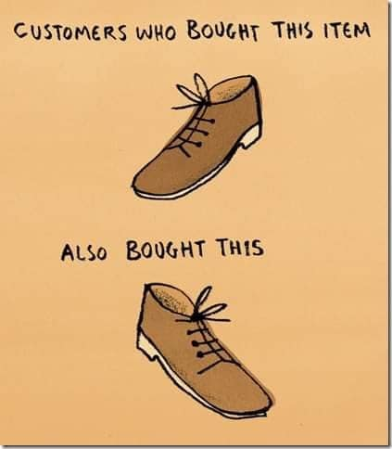
e-commerce

Slide 27
e-commerce
There are e-commerce CMSs:
Shopify (Canadian ☺)
Volusion
Magento
There are also ways to incorporate payments directly into your site:
PayPal
Stripe

Slide 28
e-commerce
Cart abandonment is an issue that e-commerce vendors hate!
This is when users begin adding items to their cart and then leave the site without placing an order.
There are marketing articles written about how to avoid the dreaded "abandoned cart" dilemma.

Slide 29
e-commerce
An option for incorporating commerce into a website is PayPal.
Set up an account that links to your bank account.
Insert "Add to cart" buttons in the site and PayPal manages the cart.
Checkout will also use a PayPal module to handle the payment.

Slide 30
e-commerce
PayPal was a popular method before because they handle and process the payments.
They also take a cut of the transactions though.
The processing of a transaction is called a payment gateway. This is not specific to PayPal.

Slide 31
e-commerce
e-commerce platforms like Shopify also include payment gateways.
Another option is to use a third-party platform like Stripe which allows you to embed a payment system in your own site.
However, they also take a cut from the transactions. ☹

